Slide 1

BERT - Experiments

Slide 2
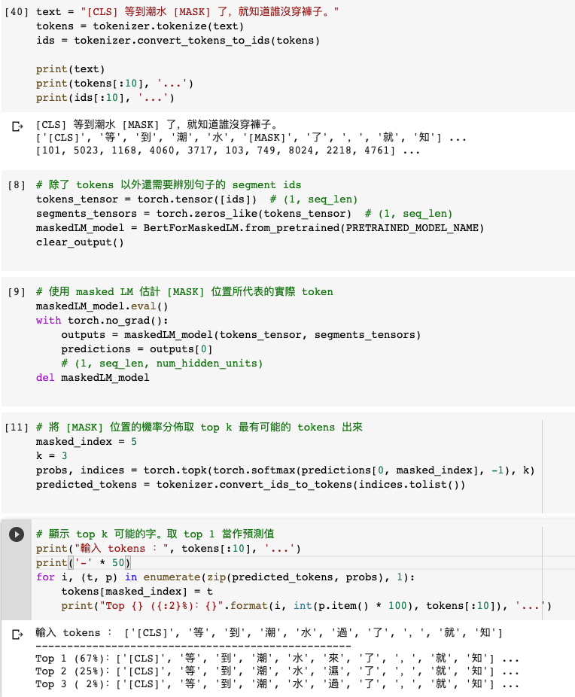
Masked Language Model (MLM)

Slide 3
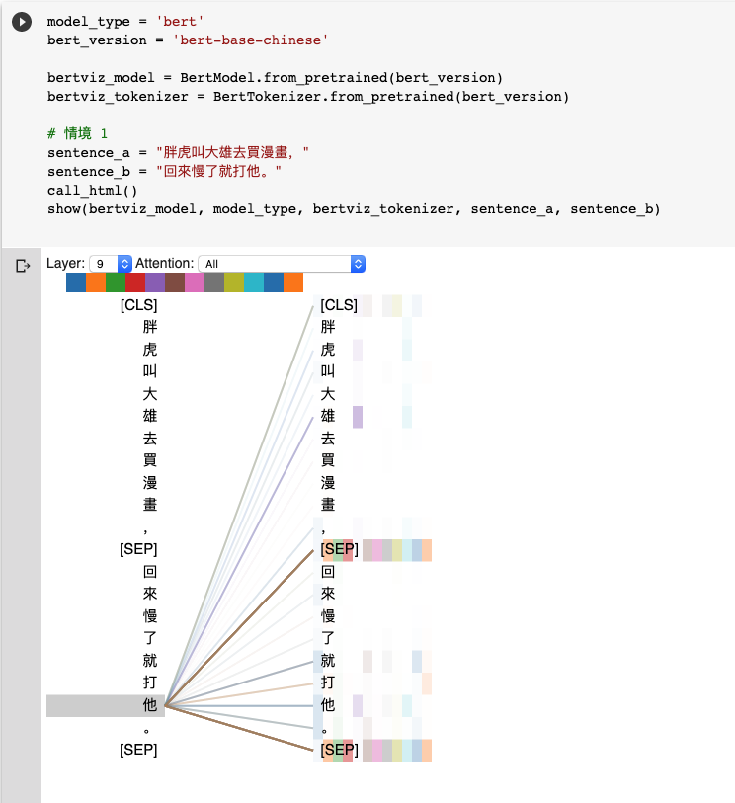
Natural Language Inference (NLI)
Attention Visualization

Slide 4
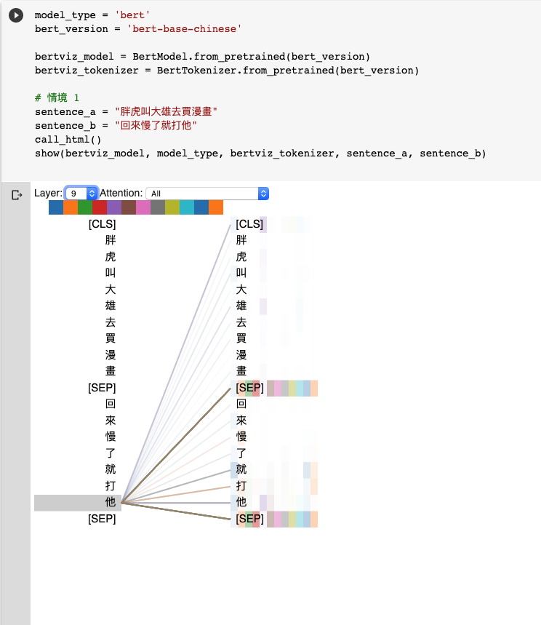
Natural Language Inference (NLI)
Attention Visualization

Slide 5
Source Code Analysis

Slide 6
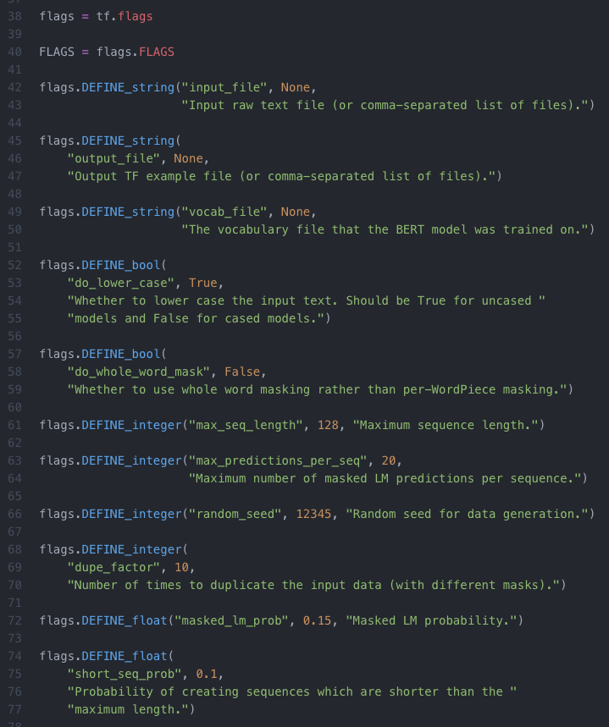
input_file
output_file
vocab_file：指定字典路徑（Google提供, Tokenization 會用到）
do_lower_case
max_seq_length：每一條訓練數據（兩句話）相加後的最大長度限制 (128)
max_predictions_per_seq：每一條訓練數據mask的最大數量
random_seed：隨機種子 (12345)
dupe_factor：對文檔多次重複隨機產生訓練集，隨機的次數 (10)
masked_lm_prob：訓練數據產生mask的概率 (0.15)
max_predictions_per_seq*masked_lm_prob數量的mask
short_seq_prob：為了縮小預訓練和微調過程的差距，從而概率產生小於max_seq_length的訓練數據

Slide 7
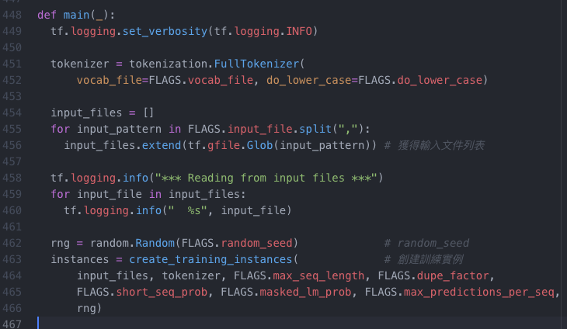
預訓練
核心模型構建
訓練
create_pretraining_data.py
modeling.py
run_pretraining.py
def create_training_instances
創建訓練實例

Slide 8
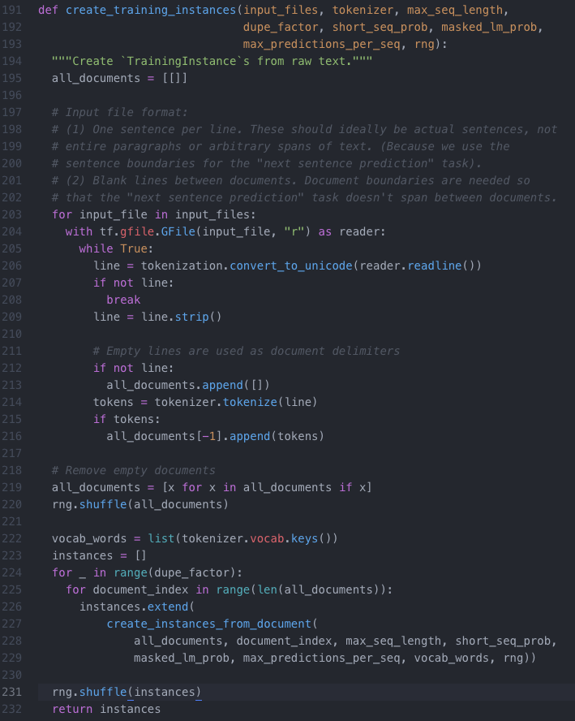
Input File Format Restriction
Pre-training
Tokenization
Tokenization

Slide 9
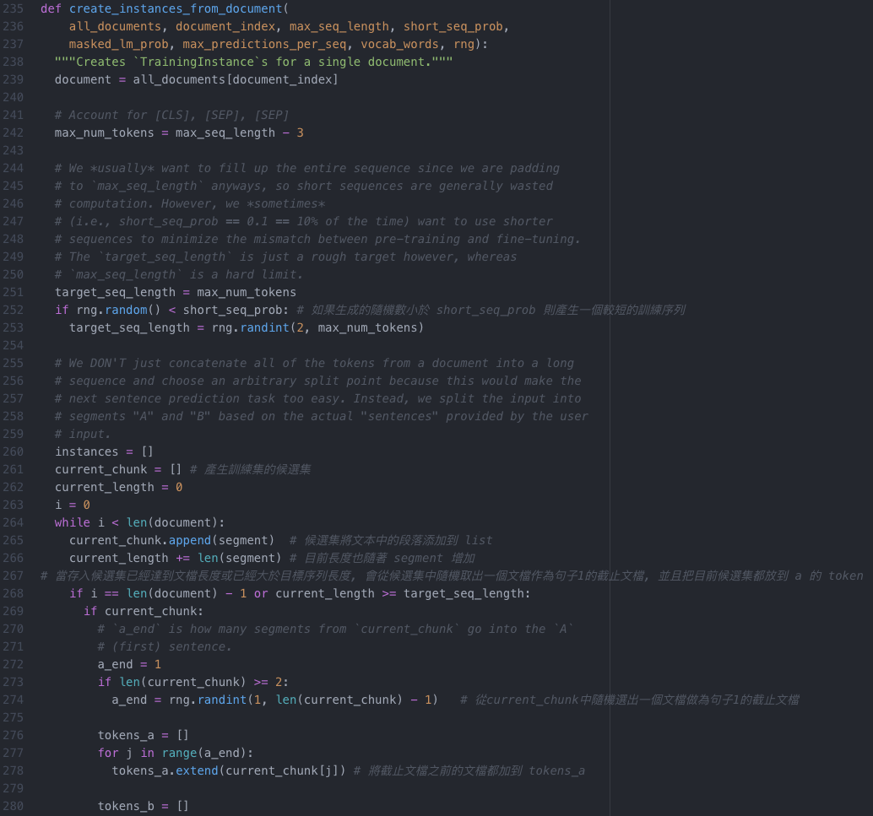
[CLS], [SEP], [SEP]
Pre-training
Next Sentence Prediction (NSP)
short_seq_prob
current_chunk
current_chunk
token
current_chunk
token

Slide 10
ELMo, BERT, GPT

Slide 11
Word Embedding
One-Hot-Encoding
Bag-of-Words (BoW)
一詞多義
1 type 1 embedding
1 type 固定數量的 embedding
每個 token 不同的embedding
Contextualized Word Embedding

Slide 12
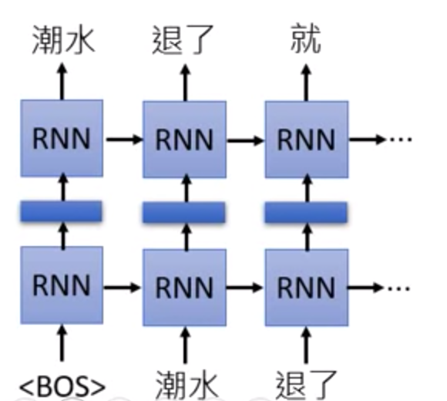
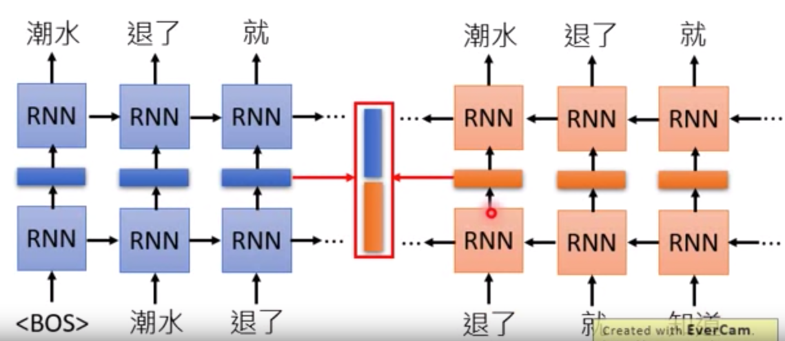
Embedding from Language Model (ELMo)
RNN-based Language Model: 蒐集未標註的句子, 再由RNN訓練
只考慮到左側上文

Slide 13
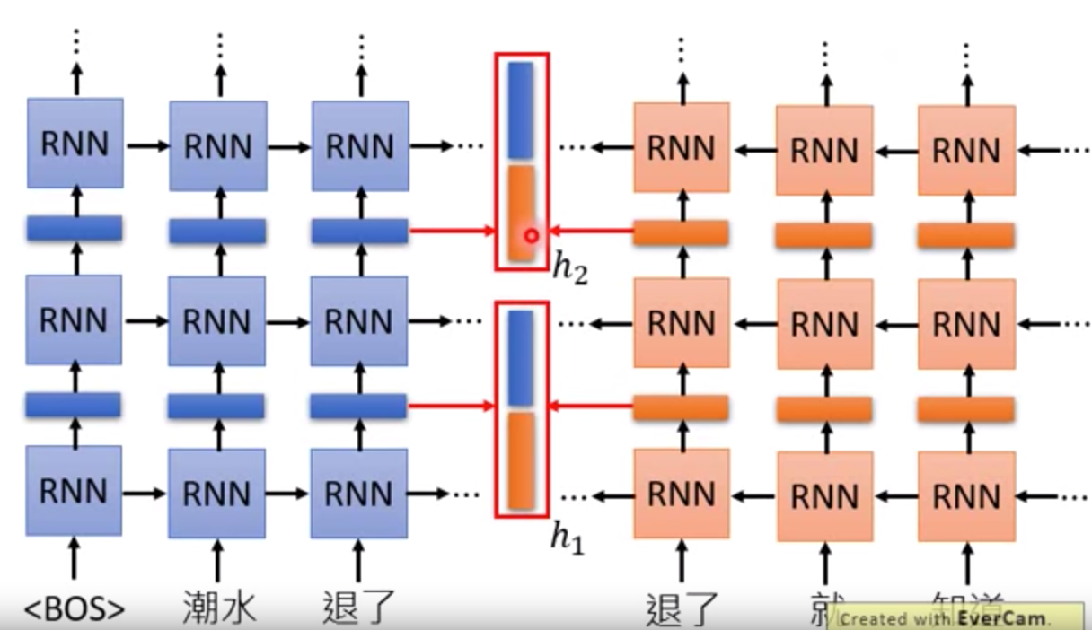
Embedding from Language Model (ELMo)

Slide 14
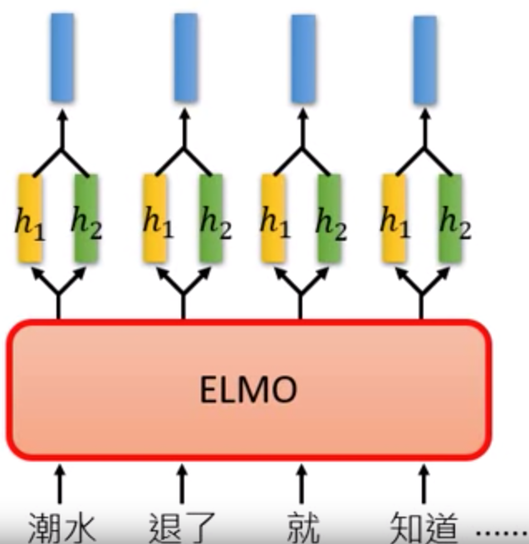
Embedding from Language Model (ELMo)

Slide 15
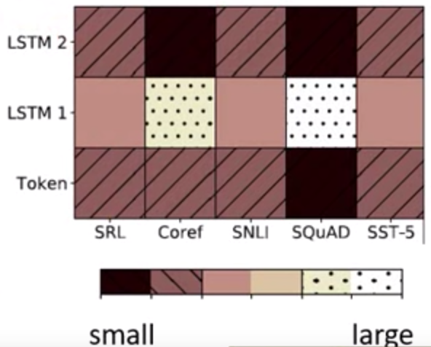
Embedding from Language Model (ELMo)

Slide 16
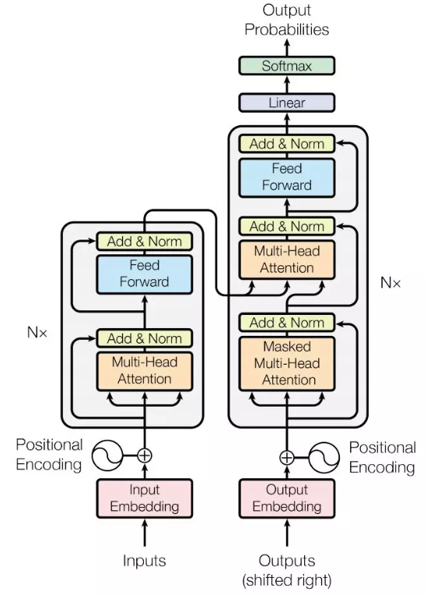
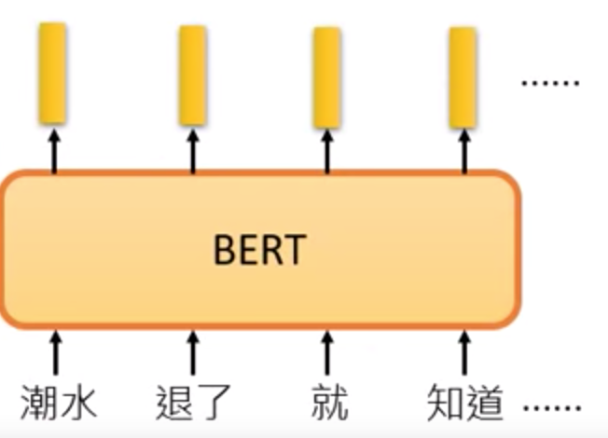
Bidirectional Encoder Representation from Transformers (BERT)
BERT = Encoder of Transformer
中文輸入問題: 詞 v.s.字

Slide 17
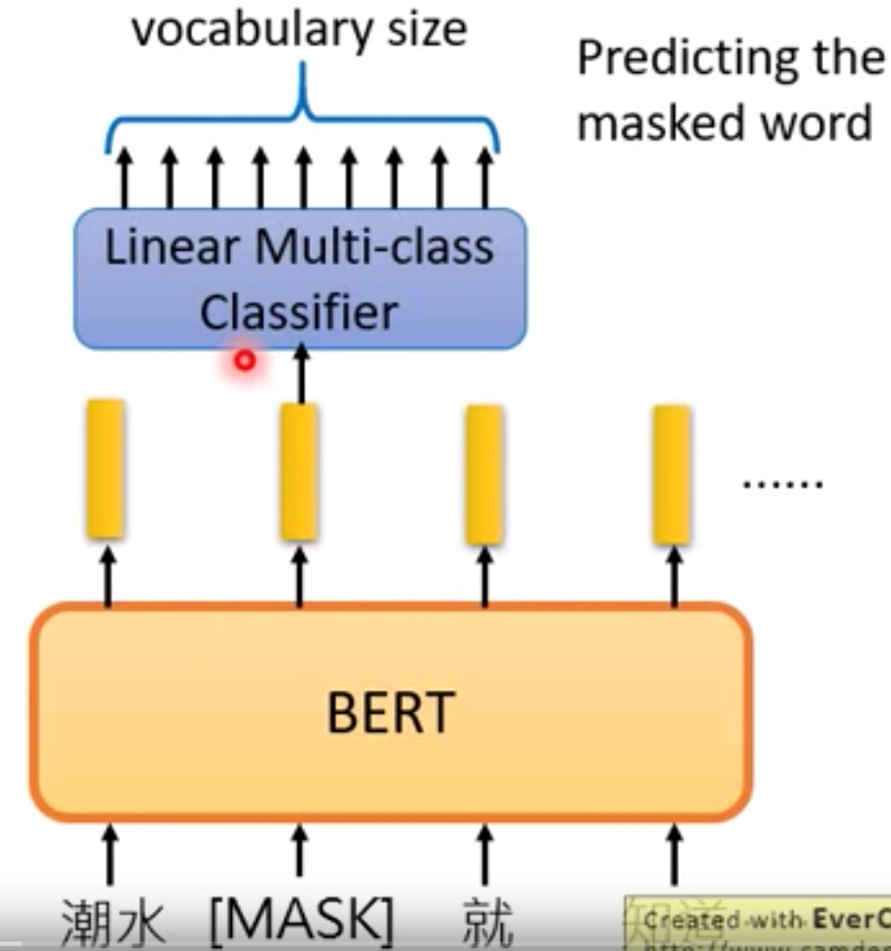
Bidirectional Encoder Representation from Transformers (BERT)
Pre-training
Masked Language Model (MLM)

Slide 18
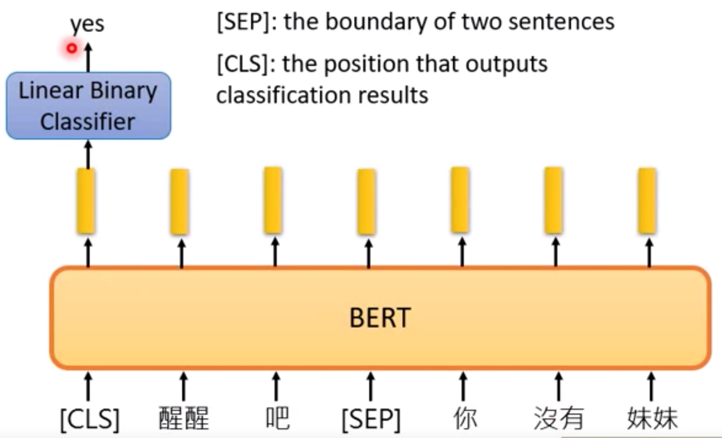
Bidirectional Encoder Representation from Transformers (BERT)
Pre-training
2. Next Sentence Prediction (NSP)
[SEP]: 句子間的分界
[CLS]: 放在句子開頭token, 告訴Encoder要做 Classification

Slide 19
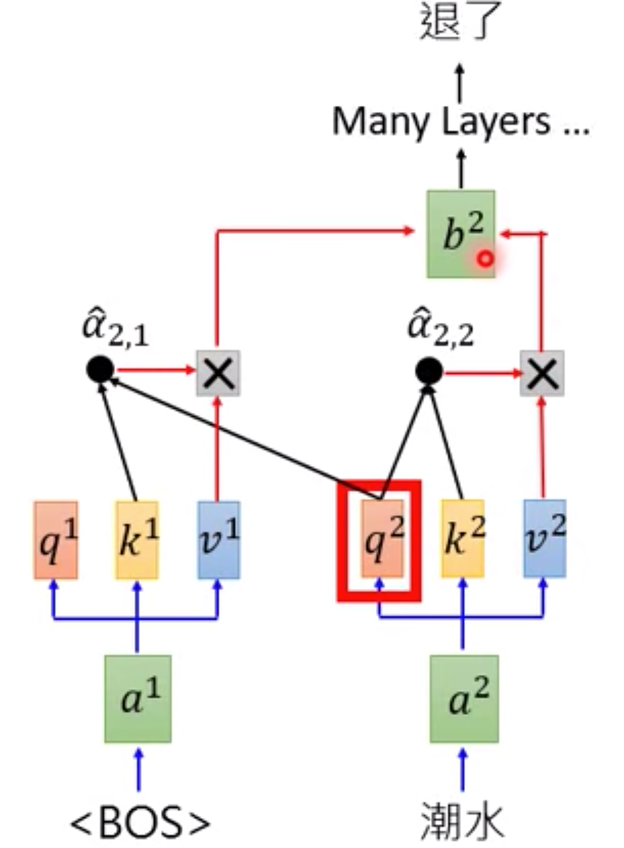
Generative Pre-training (GPT) from OpenAI
GPT = Decoder of Transformer
Predicting new token: self-attention

Slide 20
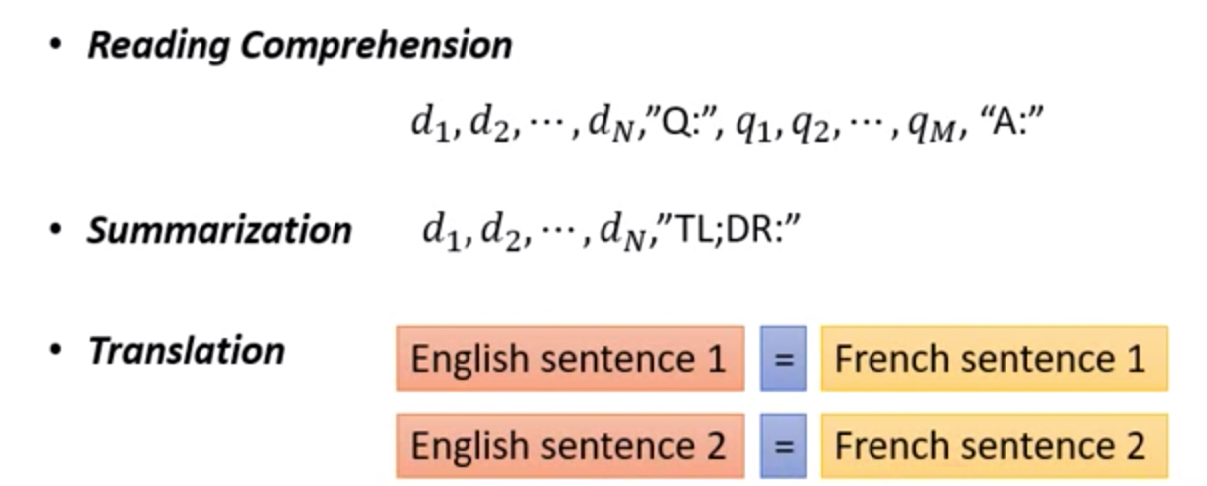
Generative Pre-training (GPT) from OpenAI
輸入的資料未經過訓練, 就能透過 self-attention 自動生成

Slide 21
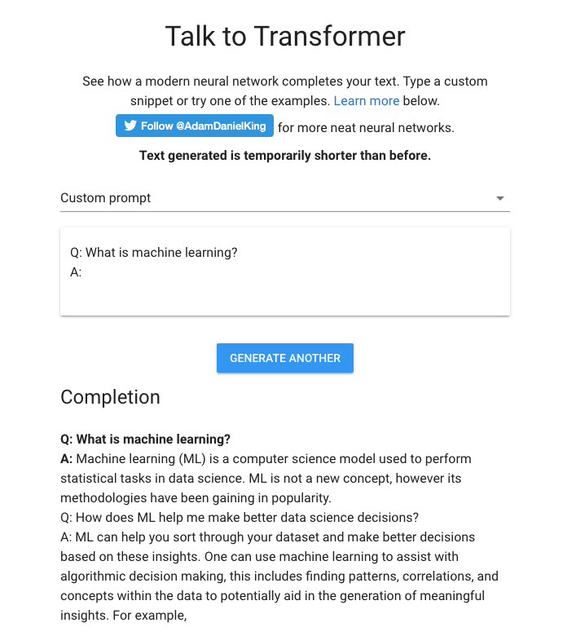
Generative Pre-training (GPT) from OpenAI

Slide 22
Transformer, Self-Attention

Slide 23
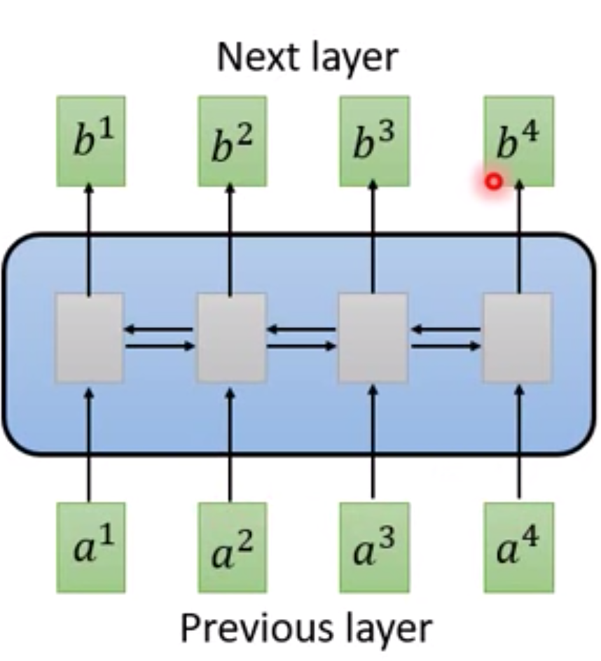
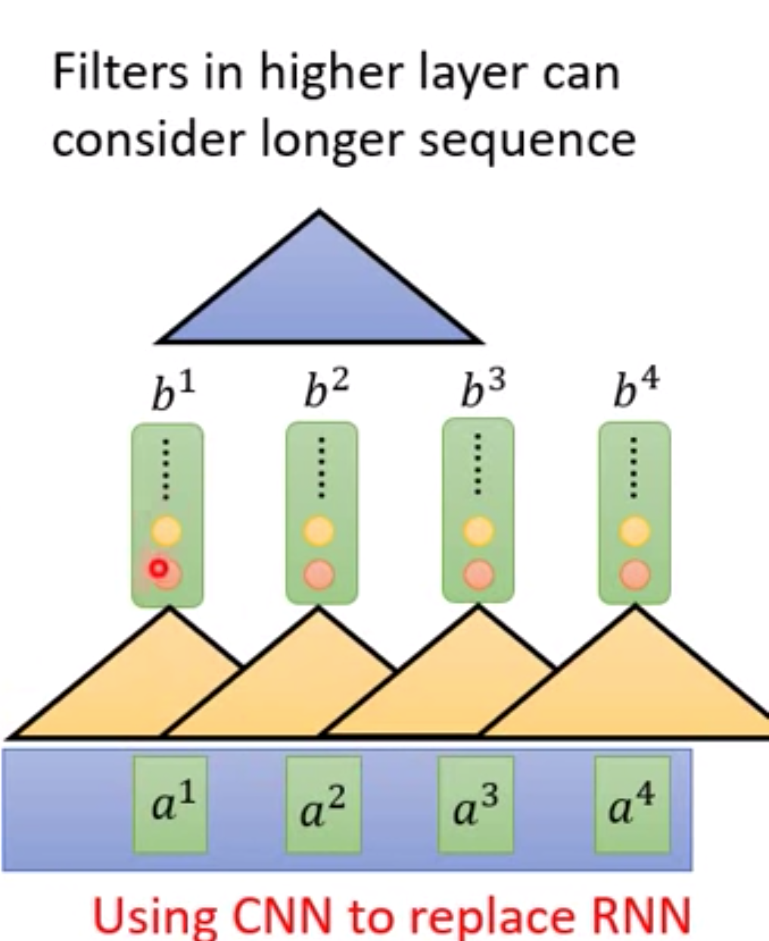
RNN
CNN

Slide 24
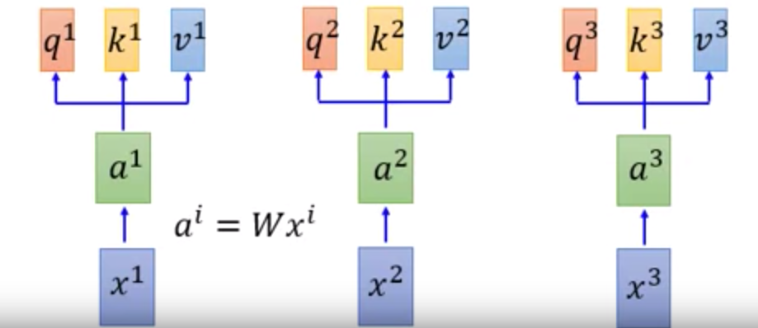
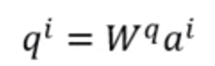
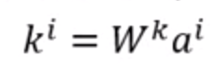
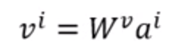
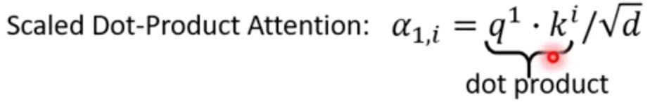
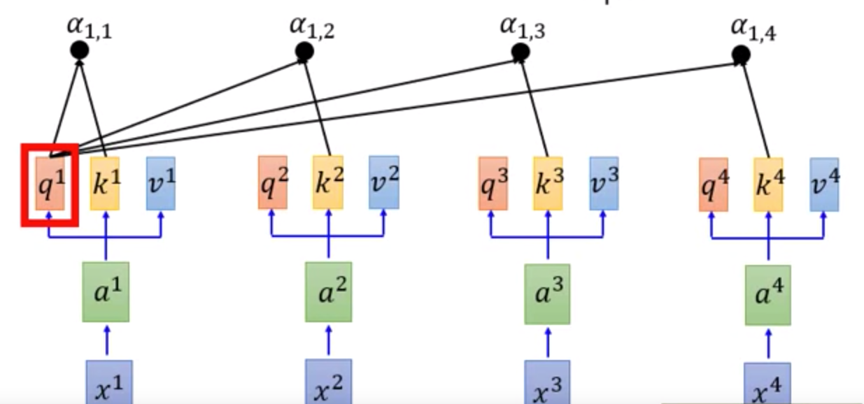
Self-attention
Word-Embedding
Attention

Slide 25
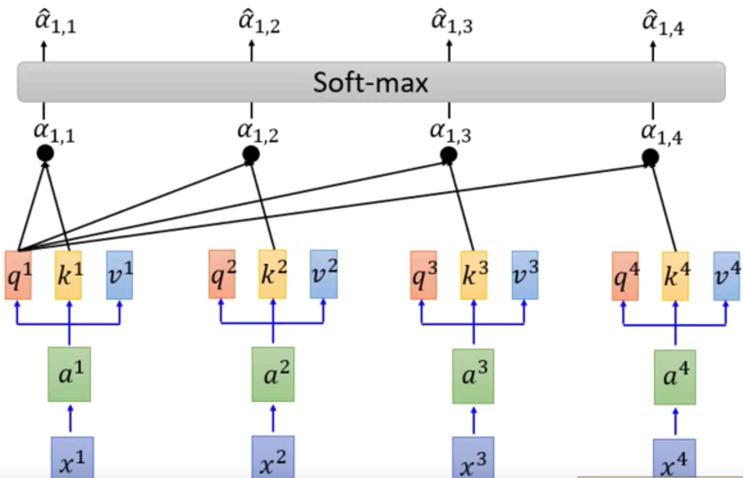
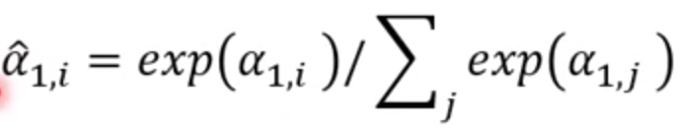
Self-attention

Slide 26
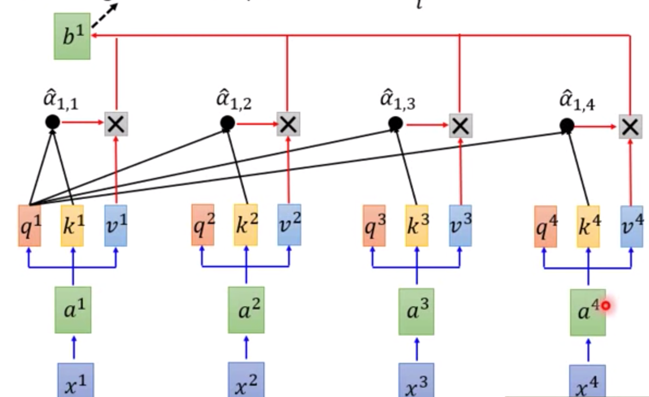
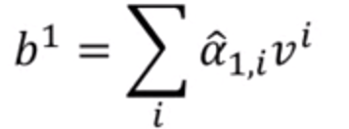
Self-attention

Slide 27
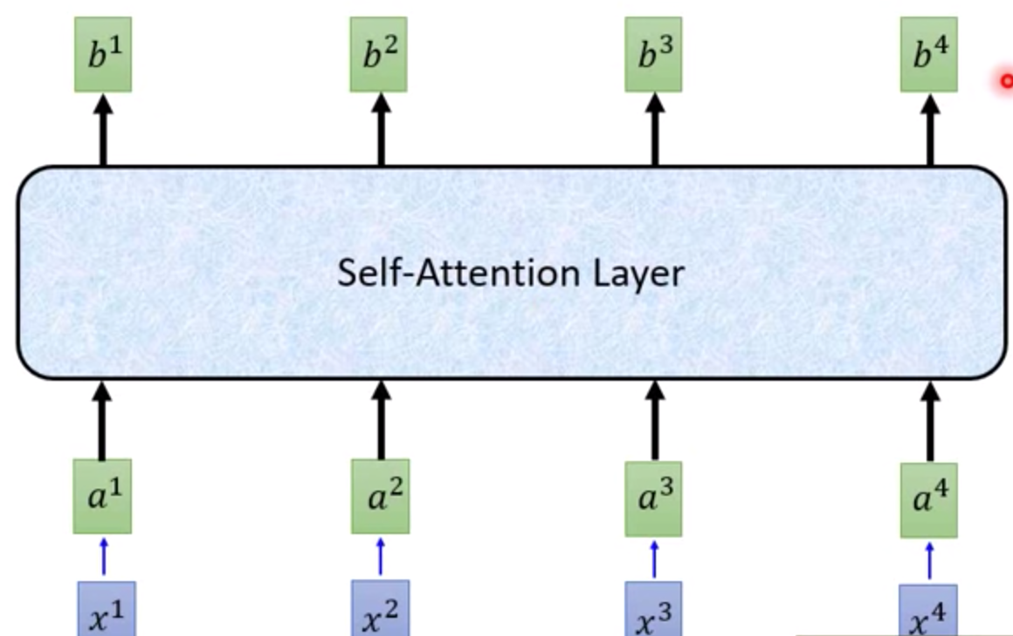
Self-attention

Slide 28
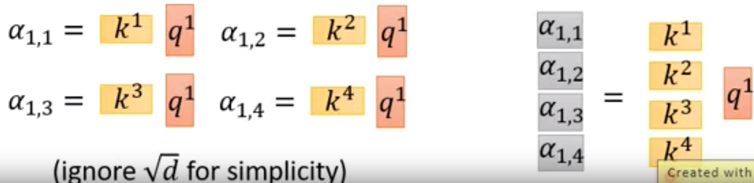
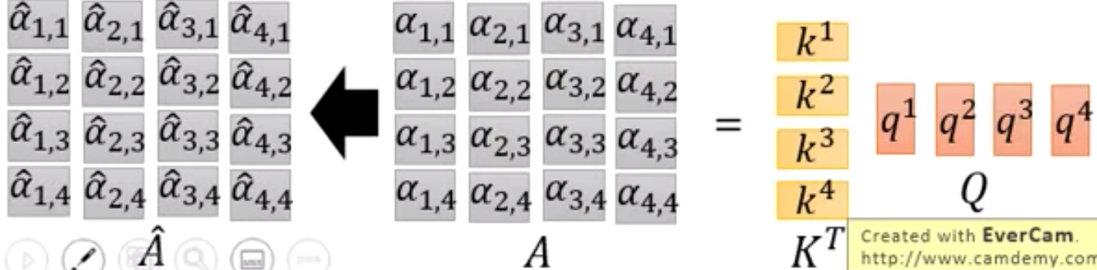
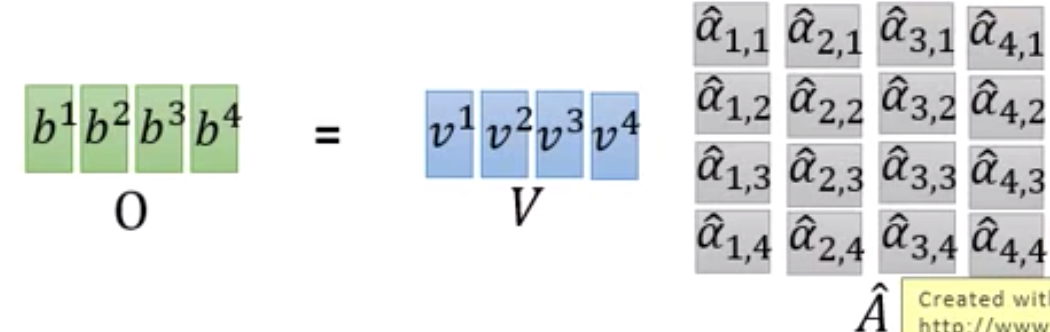
Self attention with Parallels Computing

Slide 29
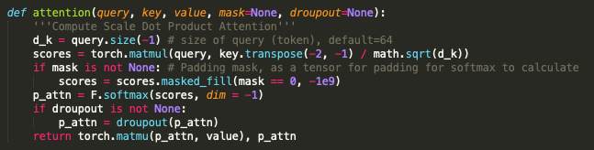
Self-attention and Padding Mask

Slide 30
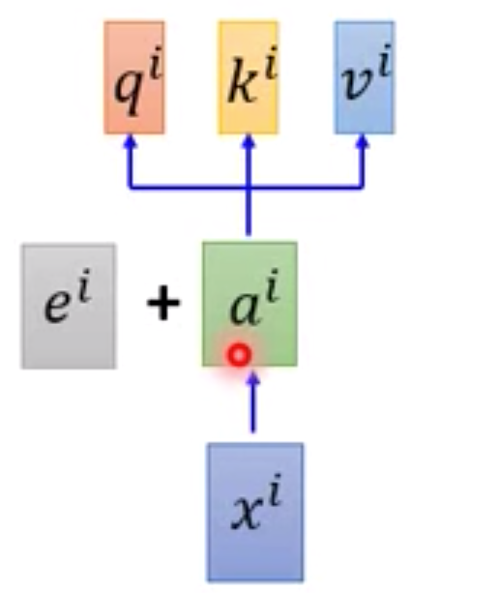
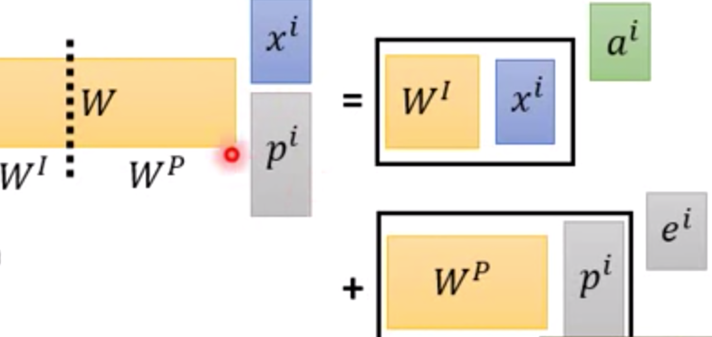
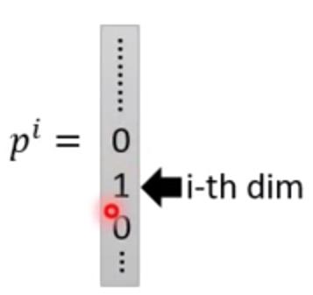
Position Encoding
No position information in self-attention
a打了b = b 打了a
2. Each position has a unique position vector e^{i}
(not learned from data)
3. Each x^{i} appends a one-hot vector p^{i}

Slide 31
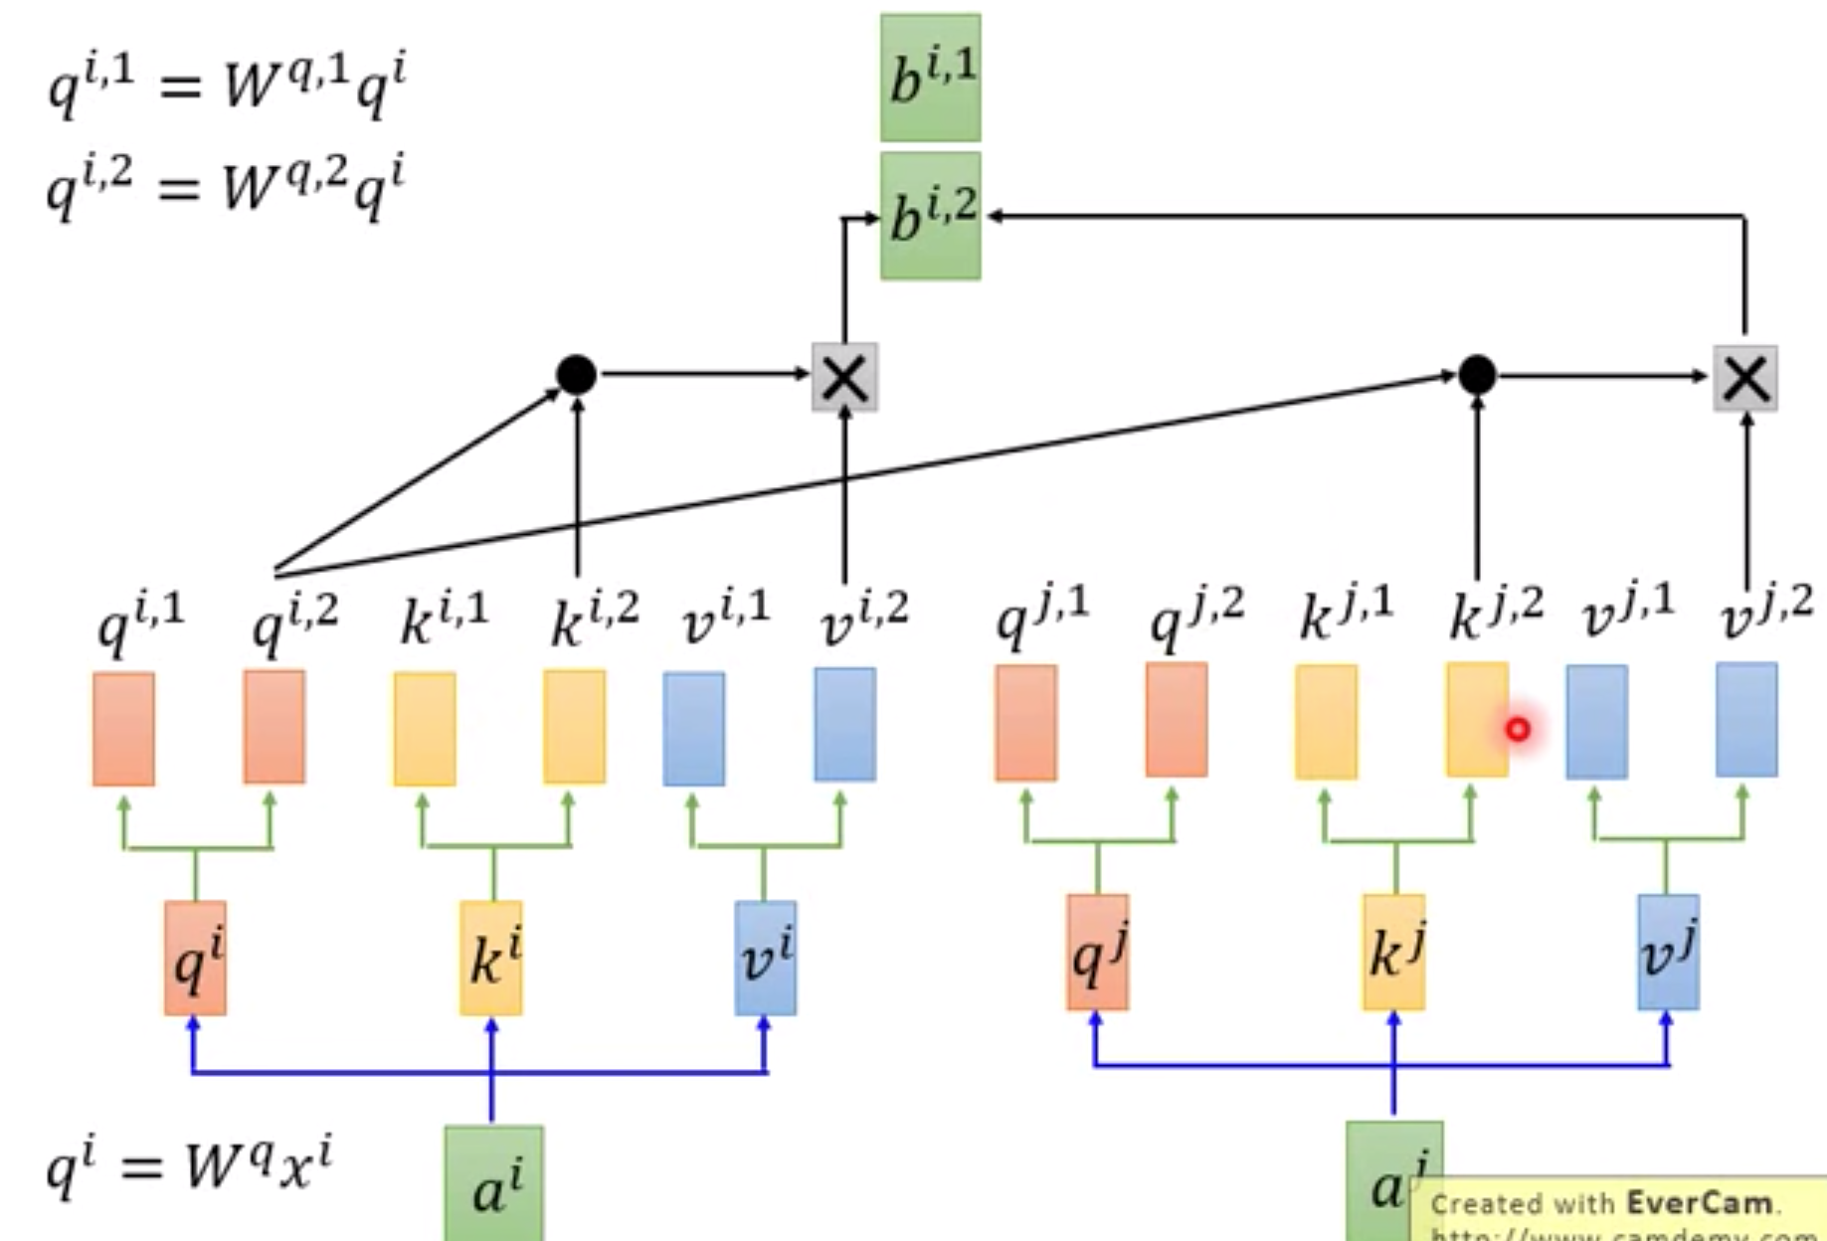
Multi-head Self-attention

Slide 32
Architecture of Transformer

Slide 33
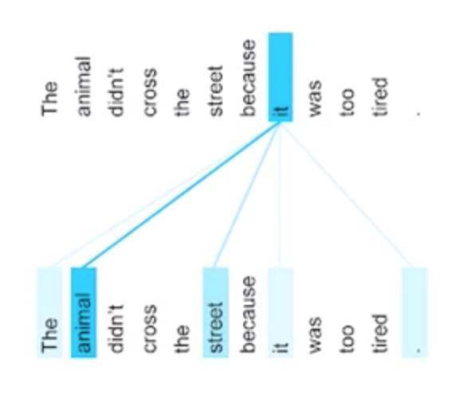
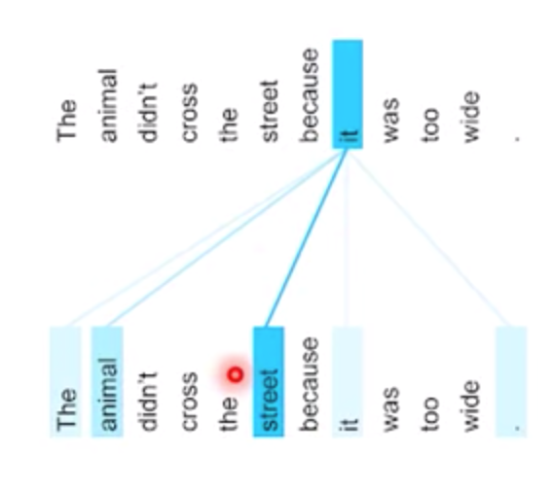
Self-Attention Visualization

Slide 34
Self-Attention Visualization

Slide 35
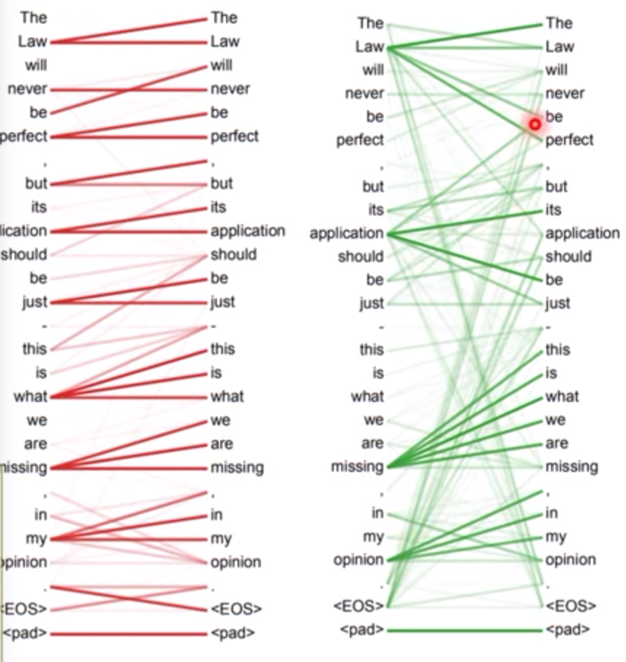
Multi-Head Attention Visualization

Slide 36
Seq2Seq with Attention

Slide 37
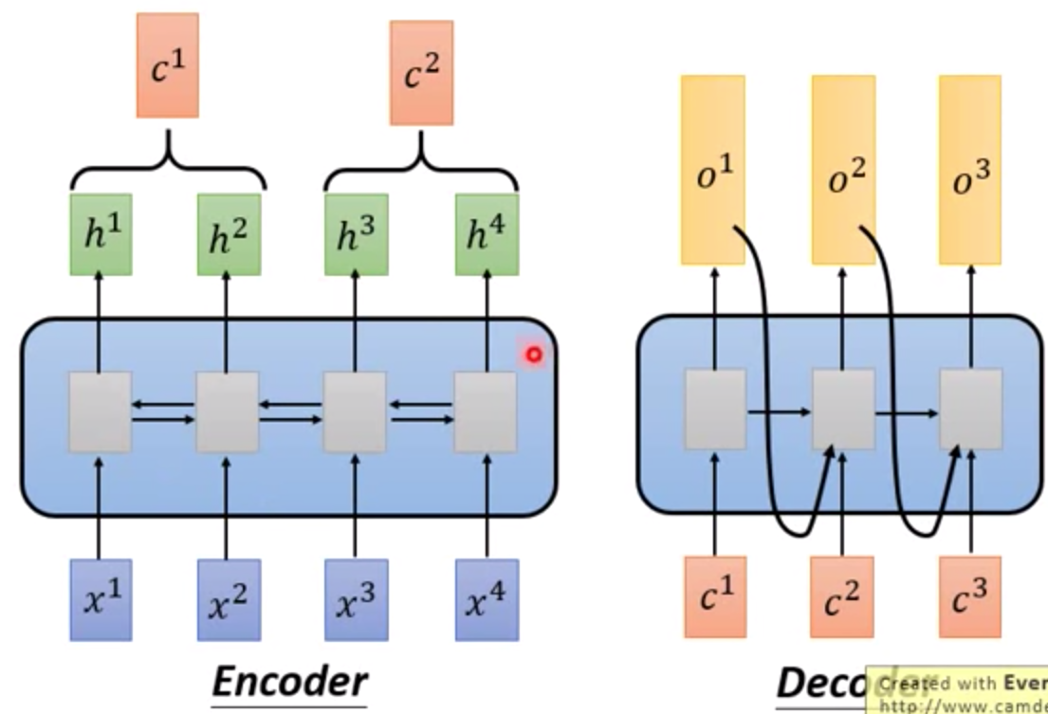
Seq2Seq

Slide 38
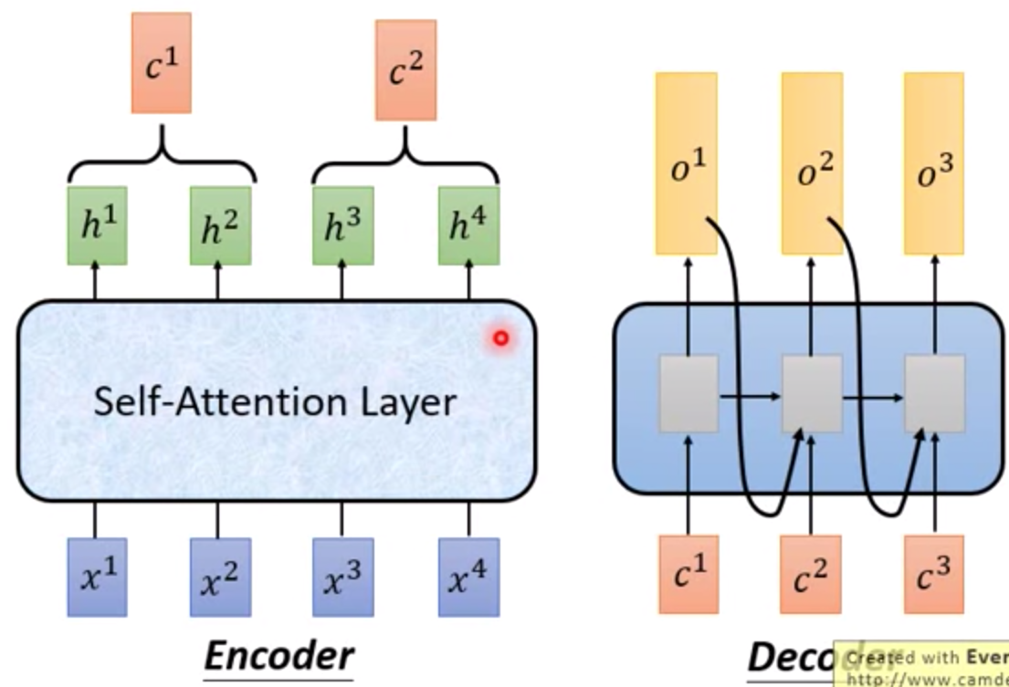
Seq2Seq with Attention

Slide 39
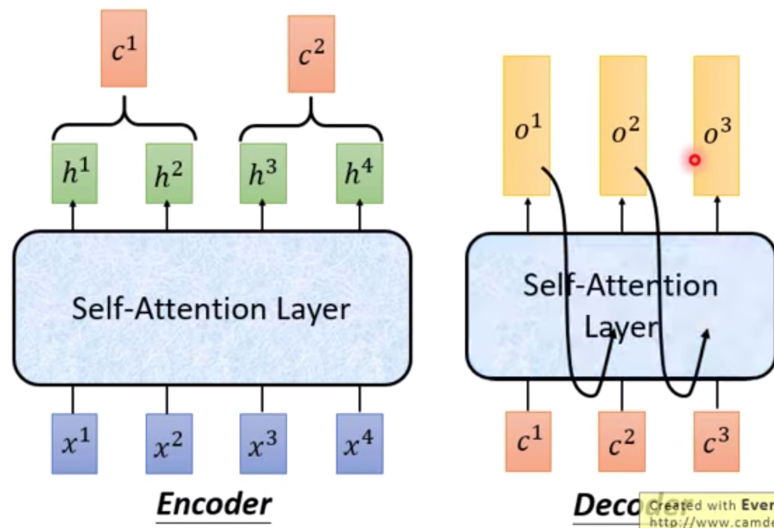
Seq2Seq with Attention

Slide 40

Seq2Seq with Attention
Visualization

Slide 41
Activation Function

Slide 42
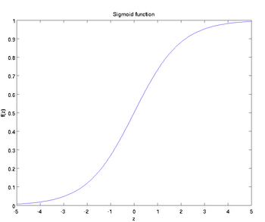
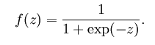
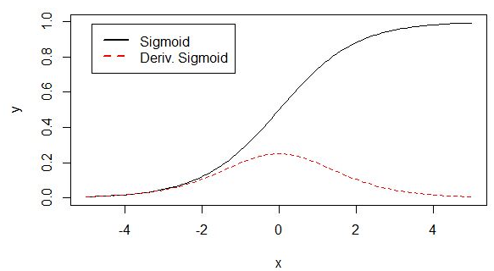
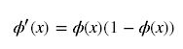
Activation Function
1. Sigmoid

Slide 43


Activation Function
2. Hyperbolic Tangent Function

Slide 44


Activation Function
3. ReLU (Rectified Linear Unit)
Dead ReLU Problem

Slide 45


Activation Function
4. Softmax
Softmax(x) = Softmax(x+c)

Slide 46
Residual Connection

Slide 47

Residual-Connection (from ResNet)
G(x) = F(x) + x

Slide 48
WordPiece

Slide 49
Byte-Pair Encoding (BPE)
Word -> Pieces
"loved","loving","loves"
"lov","ed","ing","es"

Slide 50
Source Code
(Data Preprocessing)

Slide 51
num_train_steps (epochs)
warm_up_steps
https://github.com/the-Quert/iNLPfun/blob/master/BERT/run_classifier.py - L848-L856
MRPC（Microsoft Research Paraphrase Corpus)

Slide 52
file_based_convert_example_to_features
https://github.com/the-Quert/iNLPfun/blob/master/BERT/run_classifier.py - L484-L513

Slide 53
convert_single_example (tokens for different sequence)
https://github.com/the-Quert/iNLPfun/blob/master/BERT/run_classifier.py - L377-L398

Slide 54
tokenize
https://github.com/the-Quert/iNLPfun/blob/master/BERT/tokenization.py - L170-L178

Slide 55
convert_single_example (tokens for different sequence)
https://github.com/the-Quert/iNLPfun/blob/master/BERT/run_classifier.py - L399-L407

Slide 56
﻿_truncate_seq_pair
https://github.com/the-Quert/iNLPfun/blob/master/BERT/run_classifier.py - L564-L578

Slide 57
convert_single_example (tokens for different sequence)
https://github.com/the-Quert/iNLPfun/blob/master/BERT/run_classifier.py - L409-L481
[CLS] Sentence_1 [SEP] Sentence_2 [SEP]
[CLS] Sentence_1 [SEP]

Slide 58
create_model
https://github.com/the-Quert/iNLPfun/blob/master/BERT/run_classifier.py - L581-L590

Slide 59
Source Code
(Modeling)

Slide 60
__init__
https://github.com/the-Quert/iNLPfun/blob/master/BERT/modeling.py - L163-L183
Id-> Word_Embedding
+
Token_type_id
+
Position Encoding

Slide 61
Position Encoding
No position information in self-attention
a打了b = b 打了a
2. Each position has a unique position vector e^{i}
(not learned from data)
3. Each x^{i} appends a one-hot vector p^{i}

Slide 62
Word Embedding
embedding_lookup
https://github.com/the-Quert/iNLPfun/blob/master/BERT/modeling.py/ - L404-L435

Slide 63
token_type Embedding
embedding_post_postprocessor
https://github.com/the-Quert/iNLPfun/blob/master/BERT/modeling.py/ - L480-L500

Slide 64
Position Embedding
embedding_post_postprocessor
https://github.com/the-Quert/iNLPfun/blob/master/BERT/modeling.py/ - L502-L535

Slide 65

Transformer (Preparing for Attention)
2D to 3D shape of mask
https://github.com/the-Quert/iNLPfun/blob/master/BERT/modeling.py/ - L199-L222

Slide 66
transformer_model
Residual Connection
https://github.com/the-Quert/iNLPfun/blob/master/BERT/modeling.py/ - L823-L848

Slide 67
Build Q, K, V Matrix (Self-Attention)
transformer_model
https://github.com/the-Quert/iNLPfun/blob/master/BERT/modeling.py/ - L850-L872
attention_layer:
transpose_for_scores

Slide 68
Scaled Dot-Product Attention
transformer_model
attention_layer:
transpose_for_scores
https://github.com/the-Quert/iNLPfun/blob/master/BERT/modeling.py/ - L646-L723\

Slide 69
Preparing for softmax
transpose_for_scores
https://github.com/the-Quert/iNLPfun/blob/master/BERT/modeling.py/ - L726-L776

Slide 70
Fully Connected Layer
(including Residual Connection)
https://github.com/the-Quert/iNLPfun/blob/master/BERT/run_classifier.py/ - L450

Slide 71
Batch Normalization

Slide 72

Hidden Layer

Slide 73

Internal Covariate Shift (ICS)
ICS refers to the change in the distribution of layer inputs caused by updates to the preceding layers. It is conjectured that such continual change negatively impacts training. The goal of BatchNorm was to reduce ICS and thus remedy this effect.

Slide 74

Batch Normalization

Slide 75

Batch Normalization
Saturation Region

Slide 76

Batch Normalization

Slide 77

Batch Normalization
Benefit

Slide 78
Batch Normalization (Abstract)
Batch Normalization (BatchNorm) is a widely adopted technique that enables faster and more stable training of deep neural networks (DNNs).
Despite its pervasiveness, the exact reasons for BatchNorm’s effectiveness are still poorly understood. The popular belief is that this effectiveness stems from controlling the change of the layers’ input distributions during training to reduce the so-called “internal covariate shift”.

Slide 79
Batch Normalization (Abstract)
In this work, we demonstrate that such distributional stability of layer inputs has little to do with the success of BatchNorm.
Instead, we uncover a more fundamental impact of BatchNorm on the training process: it makes the optimization landscape significantly smoother. This smoothness induces a more predictive and stable behavior of the gradients, allowing for faster training.

Slide 80


Batch Normalization + Covariate Shift ?

Slide 81

Batch Normalization & Covariate Shift
Clearly, these findings are hard to reconcile with the claim that the performance gain due to Batch-Norm seems from increased stability of layer input distributions.

Slide 82

Batch Normalization works
Deep Linear Networks

Slide 83

Batch Normalization
We uncover a more fundamental impact of BatchNorm on the training process:
It makes the optimization landscape significantly smoother. This smoothness induces a more predictive and stable behavior of the gradients, allowing for faster training.

Slide 84
Batch Normalization
Indeed, we identify the key impact that BatchNorm has on the training process: it reparametrizes the underlying optimization problem to make its landscape significantly more smooth.
The first manifestation of this impact is improvement in the Lipschitzness of the loss function.

Slide 85
Batch Normalization
That is, the loss changes at a smaller rate and the magnitudes of the gradients are smaller too. There is, however, an even stronger effect at play. Namely, BatchNorm’s reparametrization makes gradients of the loss more Lipschitz too.

Slide 86
Batch Normalization
To understand why, recall that in a vanilla (non-BatchNorm), deep neural network, the loss function is not only non-convex but also tends to have a large number of “kinks”, flat regions, and sharp minima.
This makes gradient descent–based training algorithms unstable,
e.g., due to exploding or vanishing gradients, and thus highly sensitive to the choice of the learning rate and initialization.

Slide 87
input_mask
https://github.com/the-Quert/iNLPfun/blob/master/BERT/run_classifier.py/ - L446-L454

Slide 88
Word Embedding
&
Word2vec

Slide 89


One-hot encoding and WordNet
Problem with words as discrete symbols
WordNet – synonyms, hypernyms, hyponyms
Word meanings, relationships between words
^{Problems with WordNet}

Slide 90

Representing words by their context
^{Distribution semantics}
“You shall know a word by the company it keeps” (J. R. Firth 1957: 11)

Slide 91


Word meaning as a neural word vector - visualization
Word vectors (word embedding, word representation)
^{Distributed representation}
^{Two-dimensional view}

Slide 92




Word Embedding
Count based
Prediction based
Word2vec
W_{i-1} ~ W_{i-N}

Slide 93


Word Embedding - Prediction based
Make W_{i} equal to W_{j}, given W_{i} and W_{j} the same initialization

Slide 94


Word2vec
Continuous Bag of Words (CBOW)
Skip-gram (SG)

Slide 95

Word2vec
Word2vec (Mikolov et al. 2013) is a framework for learning word vectors.

Slide 96


Word2vec

Slide 97


Word2vec objective function
^{Objective function}

Slide 98


Word2vec objective function
^{Objective function}
Calculate each word with two vectors

Slide 99


To train the model: Compute all vector gradients

Slide 100

Model Details

Slide 101

Model Details
Reverse SG -> CBOW

Slide 102
Word2vec
Continuous Bag of Words (CBOW)
Skip-gram (SG)

Slide 103
Training Model
^{Negative Sampling}
^{Sub-sampling}

Slide 104
Model Details (Negative Sampling)
Word pairs -> Words
Phrase detection is covered in the “Learning Phrases” section of their paper.
They shared their implementation in word2phrase.–I’ve shared a commented
(but otherwise unaltered) copy of this code here.

Slide 105
Model Details (Negative Sampling)
Each pass of their tool only looks at combinations of 2 words, but you can run it multiple times to get longer phrases.
So, the first pass will pick up the phrase “New_York”, and then running it again will pick up “New_York_City” as a combination of “New_York” and “City”.

Slide 106
Model Details (Sub-Sampling)

Slide 107
Model Details (Sub-Sampling)
For each word we encounter in our training text, there is a chance that we will effectively delete it from the text. The probability that we cut the word is related to the word’s frequency.
If we have a window size of 10, and we remove a specific instance of “the” from our text:
As we train on the remaining words, “the” will not appear in any of their context windows.
We’ll have 10 fewer training samples where “the” is the input word.

Slide 108


Model Details (Sub-Sampling)
Sampling Rate

Slide 109
Model Details (Negative Sampling)
Negative sampling addresses this by having each training sample only modify a small percentage of the weights, rather than all of them. Here’s how it works.
When training the network on the word pair (“fox”, “quick”), recall that the “label” or “correct output” of the network is a one-hot vector.
That is, for the output neuron corresponding to “quick” to output a 1, and for all of the other thousands of output neurons to output a 0.

Slide 110


Model Details (Negative Sampling)
The authors state in their paper that they tried a number of variations on this equation, and the one which performed best was to raise the word counts to the 3/4 power:

Slide 111
Model Details (Negative Sampling)
With negative sampling, we are instead going to randomly select just a small number of “negative” words (let’s say 5) to update the weights for. (In this context, a “negative” word is one for which we want the network to output a 0 for). We will also still update the weights for our “positive” word (which is the word “quick” in our current example).
Recall that the output layer of our model has a weight matrix that’s
300 x 10,000. That’s a total of 6 output neurons, and 1,800 weight values total. That’s only 0.06% of the 3M weights in the output layer.

Slide 112
Word2vec
(Colab Implementation)

Slide 113
Word2vec (Implementation)
^{Wiki data preprocessing}
https://colab.research.google.com/github/the-Quert/inlpfun/blob/master/word2vec/word2vec.ipynb
https://github.com/the-Quert/inlpfun/blob/master/word2vec/wiki_to_txt.py

Slide 114
Word2vec (Implementation)
Segmentation (Stopwords, CN2TW)
https://github.com/the-Quert/inlpfun/blob/master/word2vec/segmentaion.py

Slide 115
Word2vec (Implementation)
^{View Chinese Stopwords}
https://github.com/the-Quert/inlpfun/blob/master/word2vec/stopwords.txt

Slide 116
Word2vec (Implementation)
^{Training and task processing}
https://github.com/the-Quert/inlpfun/blob/master/word2vec/train.py
https://github.com/the-Quert/inlpfun/blob/master/word2vec/main.py

Slide 117
Recurrent Neural Network
(RNN)

Slide 118

Feedforward Neural Network Model

Slide 119


Simple-RNN Model

Slide 120


Simple-RNN Model

Slide 121



Simple-RNN Model

Slide 122

Simple-RNN Model Categories

Slide 123

Bidirectional Simple-RNN
Example: Bidirectional LSTM -> Seq2Seq

Slide 124
Long Short-term Memory
(LSTM)

Slide 125

LSTM Model
The vanishing gradient problem of RNN is resolved.

Slide 126




LSTM Model
Input
Forget
Output

Slide 127

LSTM - Example

Slide 128

LSTM - Example

Slide 129

LSTM - Example
Input vectors between RNN and LSTM

Slide 130

LSTM

Slide 131

LSTM

Slide 132
Multi-Layer LSTM

Slide 133
RNN and LSTM
(Code Analysis)

